Slide 1
Basic Production Planning
Adapted from Raymond Teo

Slide 2
Today’s Lecture
The thought process to planning a project
Common milestone
It’s purpose
How to plan your milestone
Creating backlog
It’s purpose
How to come up with a backlog

Slide 3
Games are expensive to make.
1 Programmer + 1 Artist + 1 Design + 1 Project Manager/QA
$3000 x 4 = $12,000
Development time : 6 months
$12,000 x 6 = $72,000
Extra : BGM, SFX, VO, Poster, Marketing, etc. = $30,000
Total : $102k (+$12,000 for every additional month delayed)

Slide 4
We need a plan!
Can we afford to make a game?
What can we make in that time?
How do make it in time?
What might go wrong?
What can we do if that happens?

Slide 5
We need a plan!
Can we afford to make a game?
What can we make in that time?
How do make it in time?
What might go wrong?
What can we do if that happens?
Scope
Steps
Risk & Mitigation

Slide 6
If you don’t have a plan, this is basically your thought process...

Slide 7
I have an idea. Let’s make a game.
START
FINISH
Game done

Slide 8
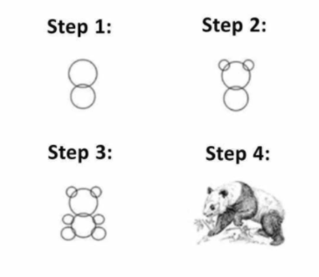
That’s pretty much your plan.

Slide 9
So let’s plan...

Slide 10

Common : I do this part, you do that part...

Slide 11

What you get...
Has the individual parts… but not what you want

Slide 12
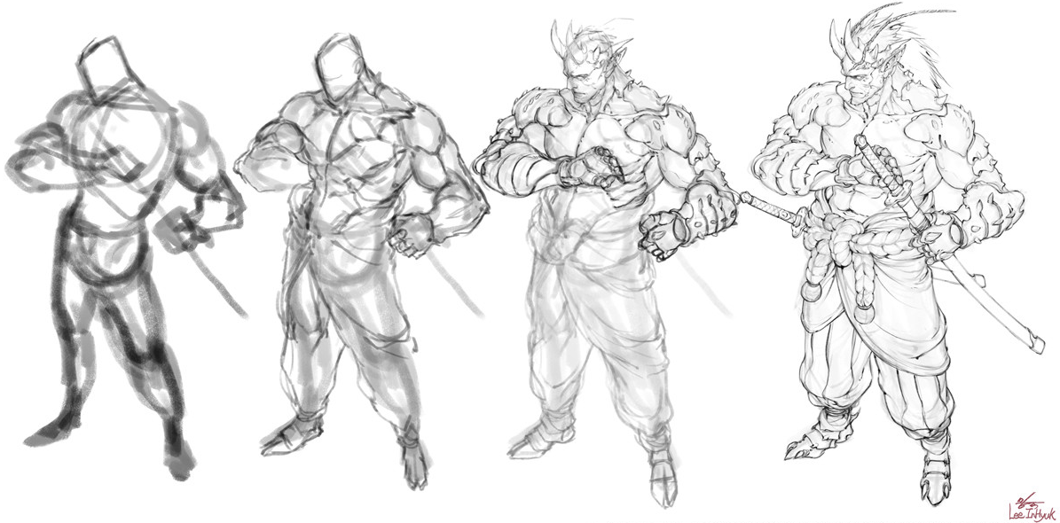
What you need...
Mold your game layer by layer. Confirm each part and move on.

Slide 13
So this...
START
FINISH
Game done

Slide 14

Break it down!
START
FINISH
Game done

Slide 15
Break it down!
START
Idea is fun Tech is doable
FINISH
Test & build system
Content & Polish
Game done

Slide 16

Break it!
Break it!
Break it!
START
Idea is fun Tech is doable
FINISH
Test & build system
Content & Polish
Game done

Slide 17
Break it down even more ?!?
START
FIRST
PLAYABLE
VERTICAL
SLICE
SYSTEM
ALPHA
BETA
FINISH
These are the common milestone in production. ( named differently in different studio/region )

Slide 18
First playable
Vertical Slice
System Alpha
Beta

Slide 19
First playable
Vertical Slice
System Alpha
Beta
> Core game loop/feature
> A level is proven fun
> All system ready to build content
> Content are built and polished

Slide 20
First playable
Vertical Slice
System Alpha
Beta
> This game has a selling point
> I can make a level around the hook. I am confident to make more levels.
> I am confident with the level. Make the system needed to build the game
> Use system to build content Polish the experience

Slide 21
First playable
Vertical Slice
System Alpha
Beta
This game is worth making
I know the game is worth making.
Now I can move on to full production

Slide 22
First playable
Vertical Slice
System Alpha
Beta
This game is worth making
Cancel? Go Ahead?
I know the game is worth making.
Now I can move on to full production

Slide 23
Exercise 1 : Identify the FP for 3 games
Form group of 3-4
Pick 3 games (Ideally something small and everyone played)
Discuss what the FP should be
Examples on next page
Note : There is no grade, but please take it seriously and ask as much question as possible. The idea is to exercise your brain to think about your 1st milestone goal through discussion.

Slide 24
Examples
Note that fun factor (or hook) is not the only consideration. It is also addressing the risk of the project. The list can also be interpreted as an “acceptance criteria”. In this case, it is defining that by FP, we need to achieve all this goals for the project to be greenlighted.
Mario 64 (Early 3D platformer)
A 3D space where player can have just running and jumping around in
Player can move and view comfortably in 3D environment
Player have fun with basic action like run and jump
Player have precision and control where he want to hit/land
Player have fun with special platforms (slope/slide/springs/etc)
Player can feel the learning curve
Zelda OoT (Early 3D combat)
A 3D space where player can fight multiple opponents at once
Player can move and view comfortably in 3D environment
Player can perform basic combat action like attack/block/dodge
Player can take on 1 enemy with ease
Player feel that he can improve his combat capability
Player can take on multiple 1 enemy
Player can take on multiple enemy in less comfortable location

Slide 25
Start
First Prototype
This can be further broken down per milestone

Slide 26
Week 1
Week 2
Week 3
Week 4
Week 5
Start
?
?
?
?
First Prototype
This can be further broken down per milestone
What’s your weekly/bi-weekly goal? Usually refer to a sprint.

Slide 27
MS 1
MS 2
MS 3
MS 4
MS 5
Start
?
?
?
?
First Prototype
It might also take multiple milestone to reach a big, important milestone. Often refer to KEY milestone.
This is often the case in bigger project.

Slide 28
It is not uncommon to fail your objective. Plan time for buffer. Avoid planning for exact amount of work.
No Time
Start
O
O
O
X
First Prototype
Highlight & figure out risky topic first.
Ask yourself “what if it doesn’t work?”

Slide 29
Summary
Split project into milestone
Define goals for each milestone
Split milestone into sprint
Define deliverable for each sprint
Planning forces the team to seat down and evaluate the project
Planning gives you predictability

Slide 30
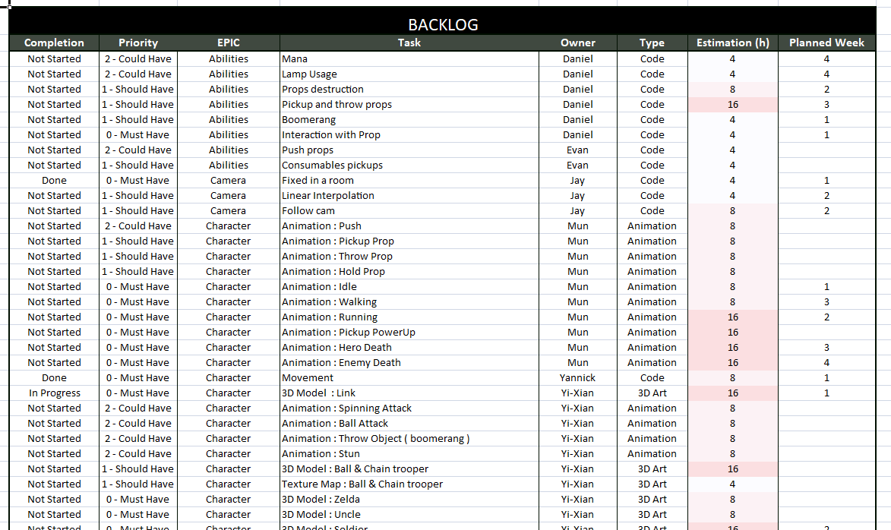
Backlog

Slide 31
What is a Backlog
A list of the work that needs to be done
Sorted and arrange in a way that is easy to use/view
Why do we need a backlog
Gives us overview
How much work?
How much time will I need?
What features are important?
What features can be cut?
When working on the backlog, the team is forced to look at the project realistically and understand the workload/challenge.

Slide 32
Backlog : Prioritize & Estimate
Epic (Category) : Large bodies of work that can be broken down into a number of smaller tasks.
Priorities: Level of importance, relative to goals
Estimate : How long it takes
Others (Subjective to your needs) Level of quality, confidence level, etc.

Slide 33
Backlog : Prioritize & Estimate
Priorities: MoSCoW method
Must have - We must have this, or we will fail.
Should have - We should have this, or we will score less.
Could have - We could have this, if we want to score more.
Won’t have - We won’t have this. Not worth the time/effort.
Estimate Time Taken:
Provided by individual member
Cross check each other. Why do you need so much time?
It’s okay to give buffer
You might want to highlight if its a risk

Slide 34
Backlog : Additional pointers
Example Scenario :
A task is stated to require 16 hours
A person working 8 hours a week takes it up
At the end of two weeks, the person finally says the task could not be finished
The team is 2 weeks behind now
Sooooo……
Do constant check-ins with everyone
Keep tasks as small and as precise in scope as possible

Slide 35
Submission
Make sure things make sense:
Assigned “Must have” tasks should not exceed the amount of time assignee has to work on projects
Etc.
Submit your excel file with this format:
<team_name>_productionplan.xlsx

Slide 36

Exercise 2 : Create a backlog for Mario [NES] in Excel
3-4 person per team
1 level (Just the level)
Include only Priority / Epic / Task / Estimate
Ignore UI/HUD but include others
Note : There is no grade, but please take it seriously and ask as much question as possible.

Slide 37
The end

